Slide 1
Exploring Simple Siamese Representation Learning
Chen, Xinlei; He, Kaiming
(FAIR)
(2020.11 Arxiv)

Slide 2
Outline
About contrastive learning, what and why?
Related Work
Motivation
This paper: SimSiam
Experiments
Analysis & Why this paper?

Slide 3
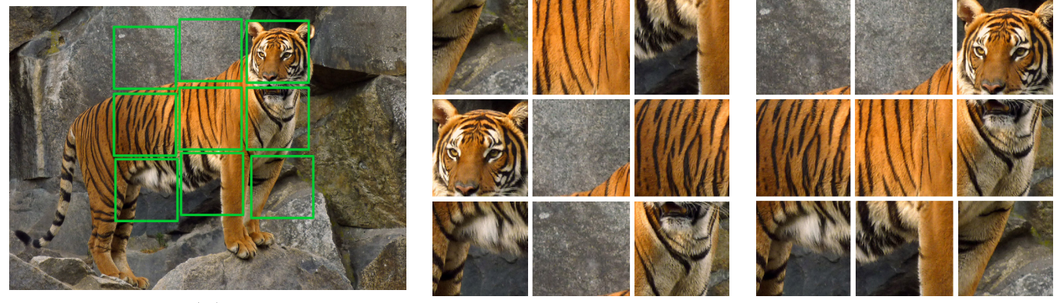
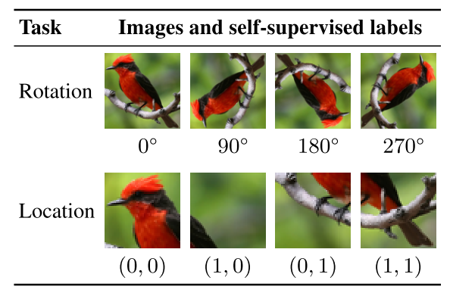
About contrastive learning, what and why?
Contrastive learning belongs to self-supervised learning
What is self-supervised learning?
  Learn a function that maps the input data onto itself. (e.g. jigsaw puzzle, rotation angle prediction, contrastive learning)
Why self-supervised learning?
  Learn a strong representation by using a large amount of unlabeled data.
Jigsaw puzzle
Rotation and location prediction
Notes:
那什么是自监督学习呢？一句话来说就是一个函数去学习到自己的一种映射。
更具体的，我可以去定义一些pretext 的task，这种pretext 可以是一个拼图游戏，或者是 旋转角度的预测。很显然的，每采样一个训练样本，都能够直接获取pretext task的对应label。
自监督学习就是通过这种方式来挖掘和提炼数据里的信息，获取更强的表征。
也可以把它理解为披着无监督的皮，在做监督学习。

Slide 4
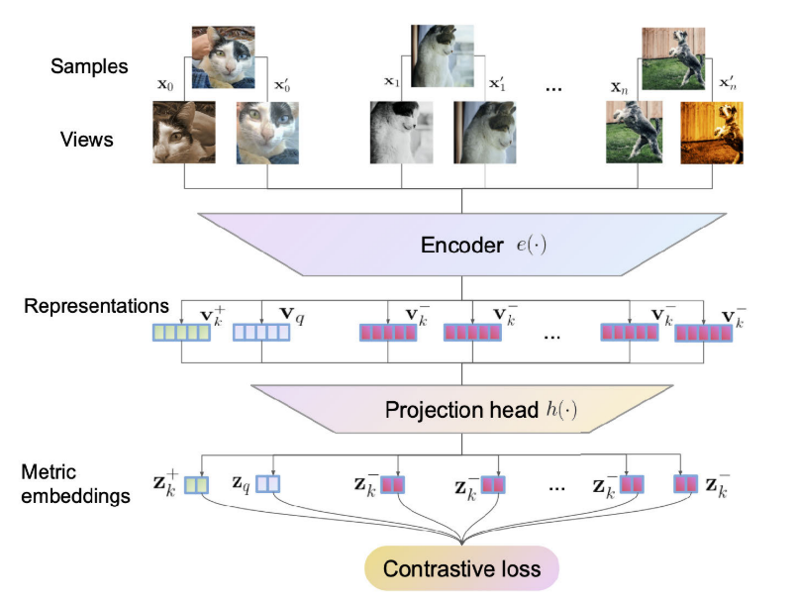
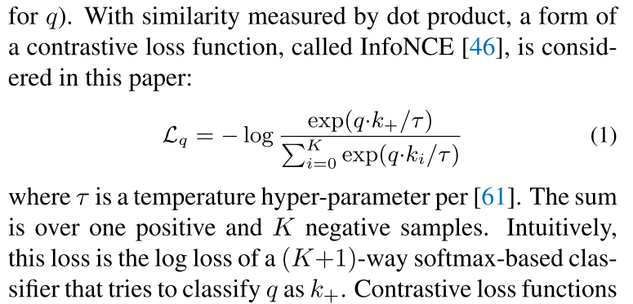
About contrastive learning, what and why?
What is contrastive learning?
  Contrastive learning is the process of training a classifier to distinguish between “similar” and “dissimilar” input data.
  “similar”: different views of a single instance(image)
  “dissimilar”: different instance(image)
  A strong hypothesis
InfoNCE
Notes:
什么是对比学习呢？对比学习就是指通过训练一个分类器，来拉近相似样本，拉远相似样本。
这里的相似样本是指同一张图片的不同view，不同的view也就是通过不同的图像变换得到的，而不相似样本是指不同样本产生的样本对。
于是乎，理想情况下，每个样本都可以通过encoder获取到他独特的有辨识度的表征了。我们就认为这样的表征很好。
值得注意的是，对比学习有一个很强的假设，就是一张图片的不同增强方式是属于一个instance，而各个图片之间，属于不同的instance。
那么这种假设到底是否合理呢？有什么可以改进的地方呢？就留给大家去思考吧，因为我也不知道。

Slide 5
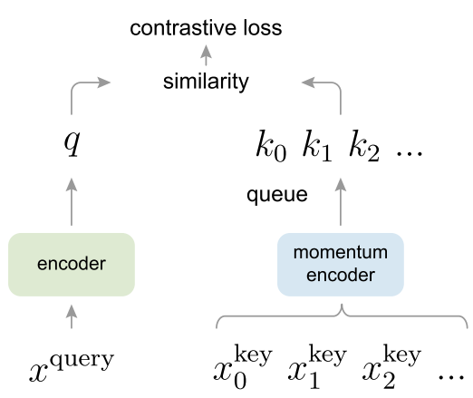
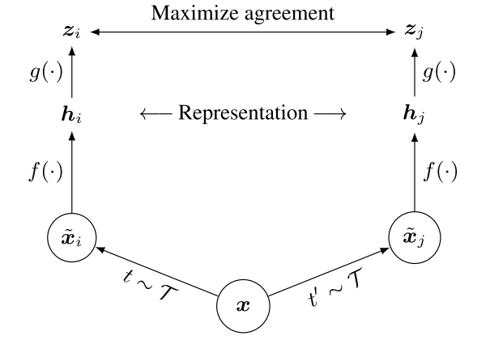
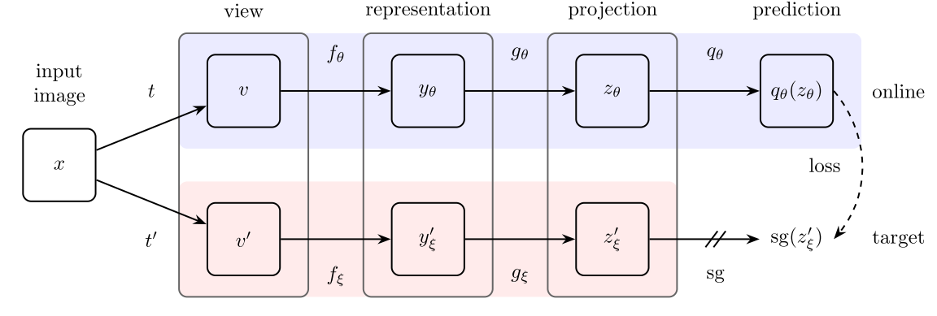
Related work
MOCOv1 & MOCOv2
SimCLR & SimCLRv2
BYOL
MOCO
SimCLR
BYOL
More clear introductions:
https://untitled-ai.github.io/understanding-self-supervised-contrastive-learning.html
https://mp.weixin.qq.com/s/-Vtl_8nND7WCPLdL5bNlMw
https://mp.weixin.qq.com/s/6qqFAQBaOFuXtaeRSmQgsQ
https://www.zhihu.com/question/402452508/answer/1294166177

Slide 6
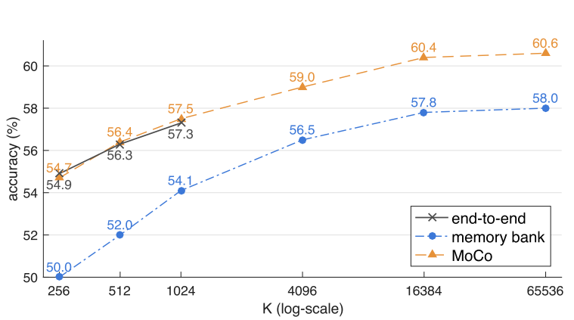
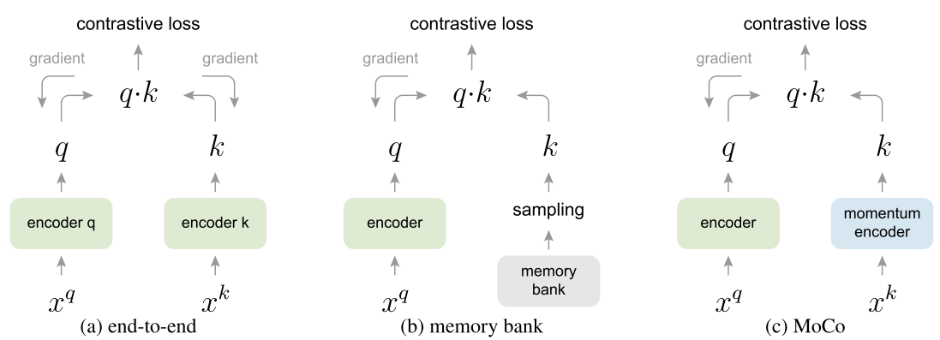
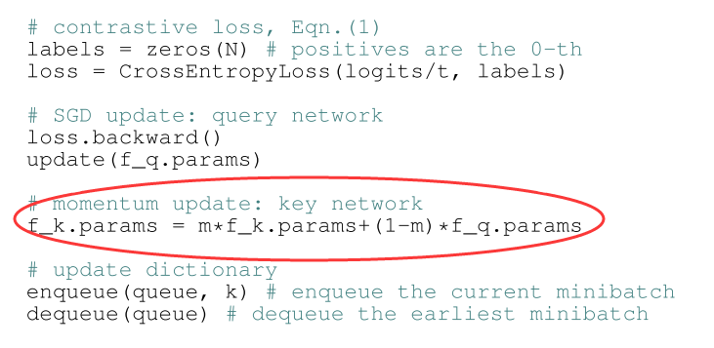
Related work
MOCOv1
  A large dictionary.
  Momentum encoder.
  Surpass ImageNet pre-trained model on 7 tasks.
Notes:
对比学习有一个特性是，负样本越多，这个任务越难，那么就更加会push网络学习怎么把样本和样本之间区分开。
所以最简单的方式就是，batch size搞得很大。但是，这对显存要求非常高。
另外一种办法就是，搞个memory bank，把之前编码好的样本存储起来，在计算loss的时候一起当作负例，这个方法的缺点就是，我编码器一直在变，memory bank里面的负例很多都是之前的，两侧就不一致了，这样也不好优化。
所以作者想了个折中的办法，他弄了个dictionary，这个dictionary很大，也是每次计算loss的时候当作负例，那这个dictionary和memory bank的区别在哪呢？就是dictionary里面的数据是不断地通过一个momentum encoder来更新的，这个momentum encoder呢，请看这里，这个m一般是0.99之类的很接近1的数字，所以momentum encoder不断地慢慢地靠近真正的encoder，从而保证了dictionary里面数据的新鲜度。

Slide 7
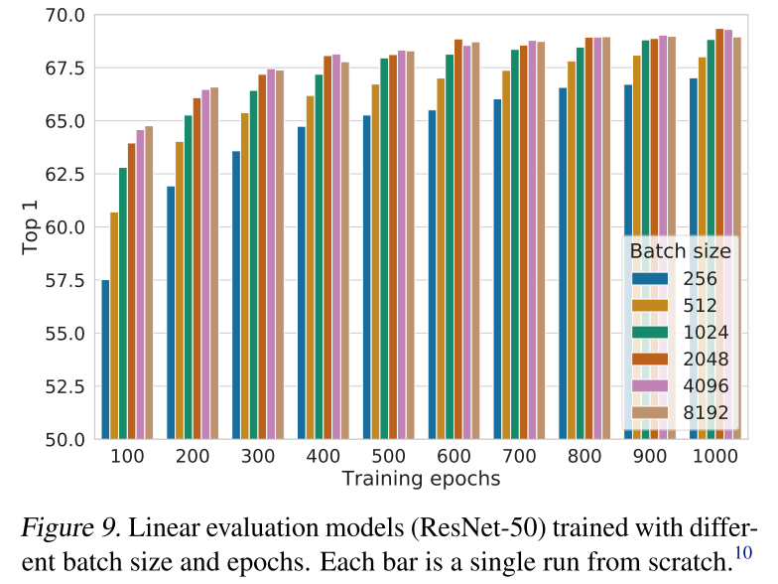
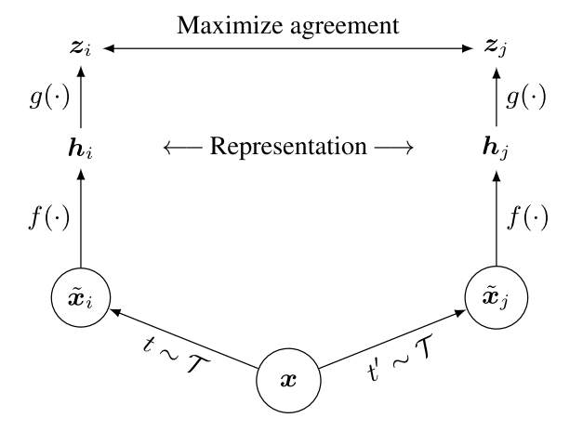
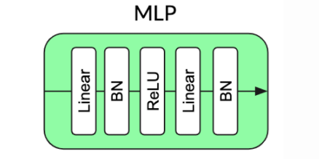
Related work
SimCLR
  Large batch size.
  Carefully designed data augmentation sequences.
  Projection head helps.
  Contrastive learning needs more time(iterations).
  Surpass MOCO for 8.5%.
Projection head
SimCLR

Slide 8
Related work
MOCOv2
  Apply projection head and carefully designed data augmentation methods on MOCO.
  Surpass SimCLR.
SimCLRv2
  Larger models performs better.
  Contrastive learning performs well on semi-supervised learning.

Slide 9
Related work
BYOL
  No need for negative samples.
  An asymmetrical architecture with a prediction head.
  Stop gradient.
  Momentum encoder.
Projection or prediction head
BYOL
What matters?
https://untitled-ai.github.io/understanding-self-supervised-contrastive-learning.html
https://arxiv.org/abs/2010.10241

Slide 10
Motivation
Is there a simpler way?

Slide 11
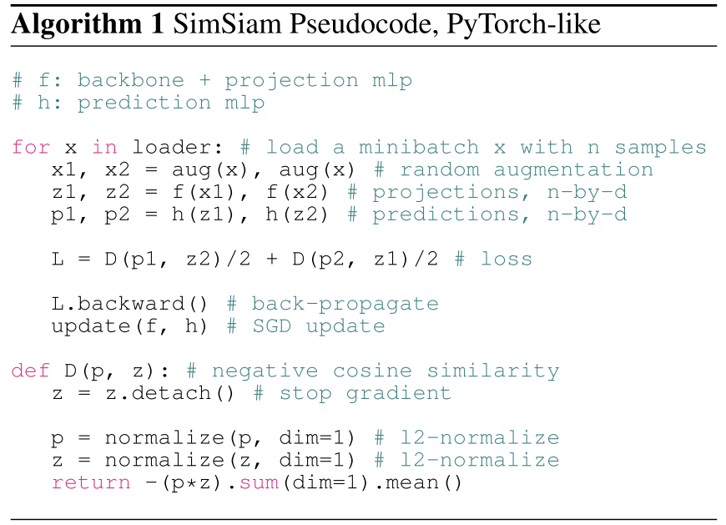
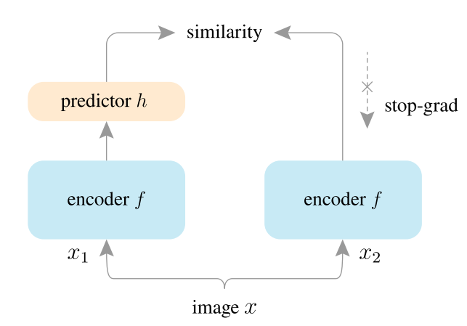



This paper: SimSiam
SimSiam
loss; forward; backward
Pseudocode
Notes:
于是就来到了今天的主角，simsiam，这个结构非常简单……
可以说他和BYOL唯一的区别就是没有用momentum。

Slide 12
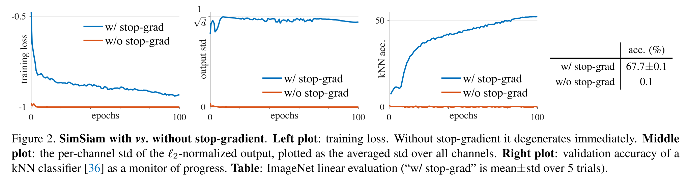
What matters?
Stop Gradient
An easy and specific explanation from the view of EM (Expectation-Maximization):
https://mp.weixin.qq.com/s/-Vtl_8nND7WCPLdL5bNlMw

Slide 13
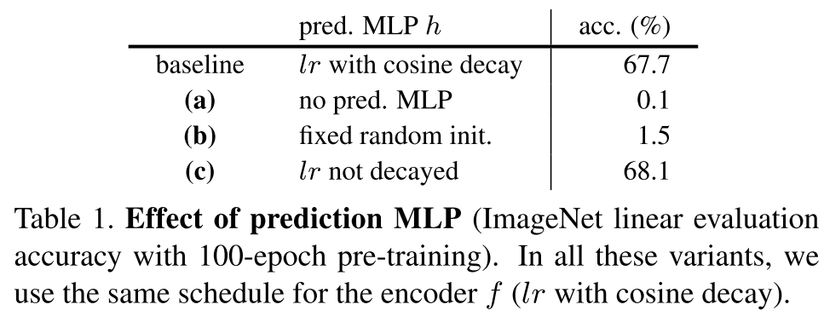
What matters?
Prediction head
An explanation from the view of implicit contrastive learning by BN:
https://untitled-ai.github.io/understanding-self-supervised-contrastive-learning.html

Slide 14
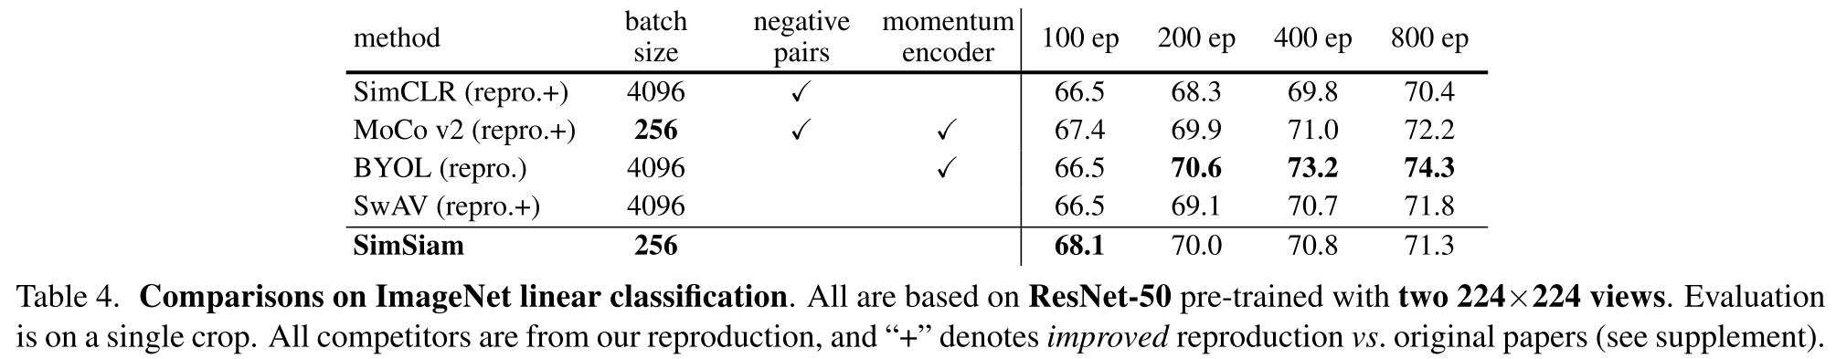
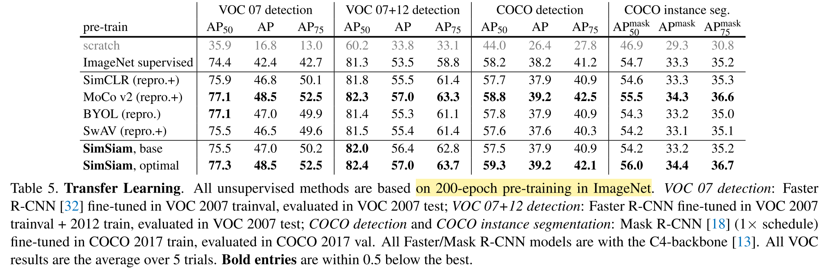
Experiments

Slide 15
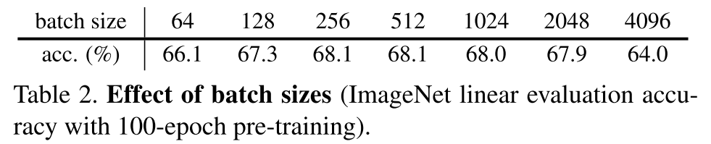
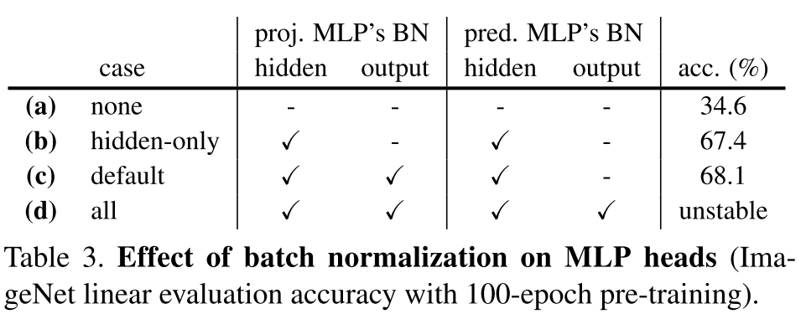
Experiments
SimSiam
Projection or prediction head
Reference about Table 3:
https://untitled-ai.github.io/understanding-self-supervised-contrastive-learning.html
https://mp.weixin.qq.com/s/-Vtl_8nND7WCPLdL5bNlMw

Slide 16
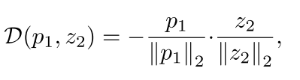

Experiments
Effects of similarity metric
Cosine similarity
Cross Entropy similarity

Slide 17
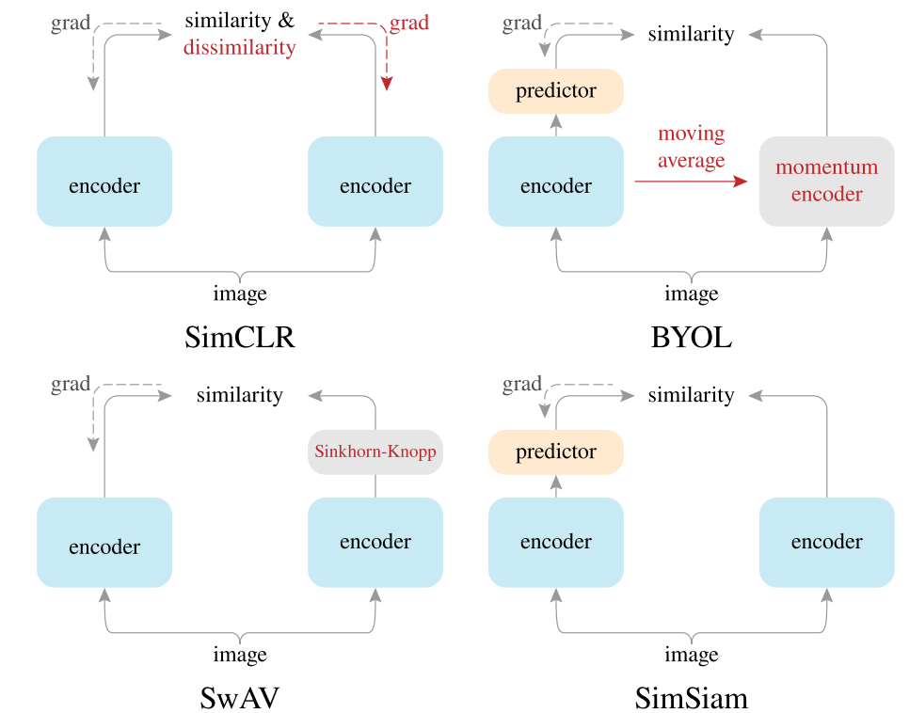
Comparison on siamese architectures
Notes:
和 SimCLR 的不同主要就在于
首先当然是有 Stop-gradient
其次没有负例对，也就是不计算 dissimilarity
和 SwAV 的不同主要在于
SwAV 在右端是用的 Sinkhorn-Knopp (SK) 变换便于聚类运算，而这里用的 stop-gradient
而和 BYOL 的不同最小
BYOL 默认就是 stop-gradient，而右端的 encoder 用的是左边的滑动平均，其实也能理解为计算了一个更平滑的目标网络

Slide 18
Analysis & Why this paper
Simple but efficient.
An introduction about contrastive learning.
Notes:
从09年的cvpr best paper，利用dark channel prior来做去雾，再到后来的resnet，faster rcnn，mask rcnn，这些工作都是实实在在的对现在计算机视觉领域起到了非常大的推动作用。
而真正当我去读这些论文的时候，发现里面的原理和操作真的并不复杂，但又设计的及其巧妙。我觉得他这样的一种能看到本质的能力和直觉，是非常值得学习的，我们可以多去思考和探究怎么给一个东西做减法，去透彻和不投机的分析一个东西的本质，这应该是有益的。

Slide 19
Reference
He, K., Fan, H., Wu, Y., Xie, S., & Girshick, R. (2020). Momentum Contrast for Unsupervised Visual Representation Learning. Proceedings of the IEEE Computer Society Conference on Computer Vision and Pattern Recognition, 9726–9735. https://doi.org/10.1109/CVPR42600.2020.00975
Grill, J. B., Strub, F., Altché, F., Tallec, C., Richemond, P. H., Buchatskaya, E., Doersch, C., Pires, B. A., Guo, Z. D., Azar, M. G., Piot, B., Kavukcuoglu, K., Munos, R., & Valko, M. (2020). Bootstrap Your Own Latent A New Approach to Self-Supervised Learning. ArXiv, 200.
Chen, X., Fan, H., Girshick, R., & He, K. (2020). Improved baselines with momentum contrastive learning. ArXiv, 1–3.
Chen, T., Kornblith, S., Swersky, K., Norouzi, M., & Hinton, G. (2020). Big Self-Supervised Models are Strong Semi-Supervised Learners. ArXiv, NeurIPS, 1–18.
Le-Khac, P. H., Healy, G., & Smeaton, A. F. (2020). Contrastive Representation Learning: A Framework and Review. IEEE Access, 8, 193907–193934. https://doi.org/10.1109/ACCESS.2020.3031549
Chen, X., & He, K. (2020). Exploring Simple Siamese Representation Learning. Figure 1. http://arxiv.org/abs/2011.10566
Chen, T., Kornblith, S., Norouzi, M., & Hinton, G. (2020). A simple framework for contrastive learning of visual representations. ArXiv, Figure 1.
https://untitled-ai.github.io/understanding-self-supervised-contrastive-learning.html
https://mp.weixin.qq.com/s/6qqFAQBaOFuXtaeRSmQgsQ
https://mp.weixin.qq.com/s/-Vtl_8nND7WCPLdL5bNlMw

